Slide 1
Chapter 5 CPU Scheduling

Slide 2
教学内容、目标与要求
教学内容
基本概念和调度原则
调度算法
多处理器调度
线程调度
算法评价
教学重点与难点
重点：1、2
难点：2
教学目标与要求
理解CPU调度概念和原则；
掌握各种CPU调度算法；
理解多处理器调度问题。

Slide 3
Types of Scheduling
long-term scheduling | Determines which programs are admitted to the system for processing. Controls the degree of multiprogramming.
medium-term scheduling | Part of the swapping function. Based on the need to manage the degree of multiprogramming.
short-term Scheduling | Known as the dispatcher. Executes most frequently. Invoked when an event occurs, e.g. Clock interrupts, I/O interrupts, Operating system calls, Signals.
I/O scheduling | The decision as to which process's pending I/O request shall be handled by an available I/O device.

Slide 4
各级调度之间的关系
外存
Swapped
ready
Swapped
waiting
提交
状态
收容
状态
交换
内存
ready
waiting
作业调度
running
terminated
进程调度

Slide 5
Contents
5.1 Basic Concepts
5.2 Scheduling Criteria
5.3 Scheduling Algorithms
5.4 Multiple-Processor Scheduling
5.5 Thread scheduling
5.6 Operating Systems Examples
5.7 Algorithm Evaluation

Slide 6
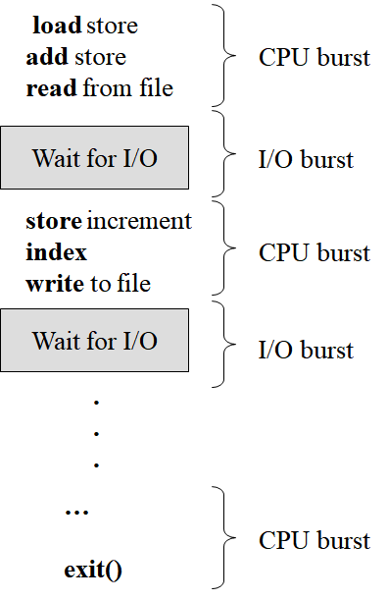
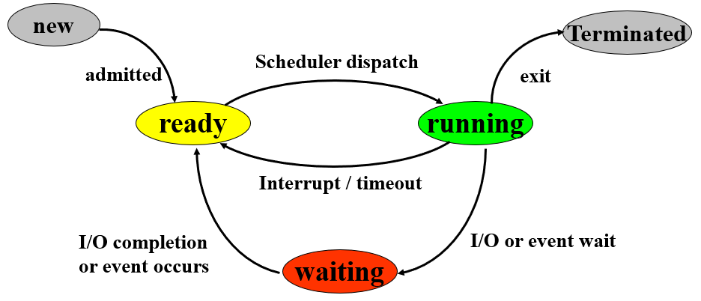
5.1 Basic Concepts
The objective of multiprogramming is to have some process running at all times. To maximize CPU utilization.
CPU–I/O Burst Cycle
Process execution consists of a cycle of CPU execution and I/O wait.
CPU burst distribution

Slide 7
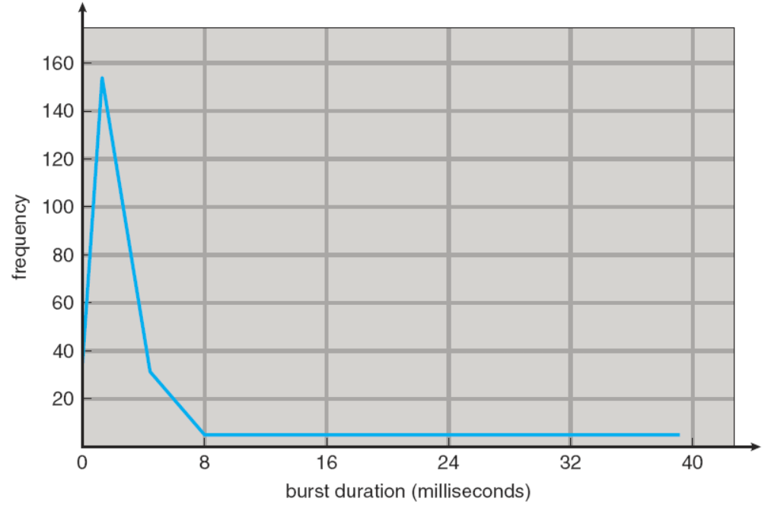
Histogram of CPU-burst Times

Slide 8
CPU Scheduler
The scheduler selects among the processes in memory that are ready to execute, and allocates the CPU to one of them.
CPU scheduling decisions may take place when a process:
1. terminates.
2. switches from running to waiting state.
3. switches from running to ready state.
4. switches from waiting to ready.
nonpreemptive
preemptive

Slide 9
Decision Mode
Nonpreemptive
Once a process is in the running state, it will continue until it terminates or blocks itself for I/O.
once the CPU has been allocated to a process, the process keeps the CPU until it releases the CPU either by terminating or by switching to the waiting state.
Preemptive
Currently running process may be interrupted and moved to the ready state by the operating system.
Allows for better service since any one process cannot monopolize(独占) the processor for very long.
preemptive scheduling can result in race conditions when data are shared among several processes.

Slide 10
Dispatcher
Dispatcher module gives control of the CPU to the process selected by the short-term scheduler; this involves:
switching context
switching to user mode
jumping to the proper location in the user program to restart that program
Dispatch latency – time it takes for the dispatcher to stop one process and start another running.

Slide 11
5.2 Scheduling Criteria
综合最优
CPU utilization – keep the CPU as busy as possible
In a real system, range from 40% to 90%
throughput (吞吐量) – the number of processes that complete their execution per time unit.
turnaround time (周转时间) – amount of time to execute a particular process.
The interval from the time of submission of a process to the time of completion.
waiting time – amount of time a process has been waiting in the ready queue.
the sum of the periods spent waiting in the ready queue.
response time – amount of time it takes from when a request was submitted until the first response is produced, not output (for time-sharing environment)
→Max
→Max
→Min
→Min
→Min

Slide 12
Classification of Scheduling Criteria
 | Performance Related Quantitative (定量的) | not performance Related Qualitative (定性的)
user oriented | turnaround time waiting time response time | predictability Deadline
system oriented | throughput CPU utilization | fairness forced priority balance resources

Slide 13
5.3 Scheduling Algorithms
First-Come, First-Served (FCFS) Scheduling
Shortest-Job-First (SJF) Scheduling
Priority Scheduling
Round Robin (RR) Scheduling
Multilevel Queue Scheduling
Multilevel Feedback Queue Scheduling
Highest Response-Ratio Next (HRRN) scheduling*

Slide 14

First-Come First-Served (FCFS) Scheduling
Each process joins the ready queue, a FIFO queue.
When the current process ceases to execute, the oldest process in the ready queue is selected.
The FCFS scheduling algorithm is nonpreemptive.
for example: Process Burst Time
P₁ 24
P₂ 3
P₃ 3
Suppose that the processes arrive in the order: P₁, P₂, P₃ The Gantt Chart for the schedule is:
Waiting time for P₁ = 0; P₂ = 24; P₃ = 27
Average waiting time: (0 + 24 + 27)/3 = 17

Slide 15

FCFS Scheduling
遵守秩序，排队！先到先得
A short process may have to wait a very long time before it can execute.
Favors CPU-bound processes.
I/O processes have to wait until CPU-bound process completes.
Suppose that the processes arrive in the order: P₂ , P₃ , P₁ .
The Gantt chart for the schedule is:
Waiting time for P₁ = 6; P₂ = 0; P₃ = 3
Average waiting time: (6 + 0 + 3)/3 = 3
Convoy(护航) effect: short process behind long process

Slide 16
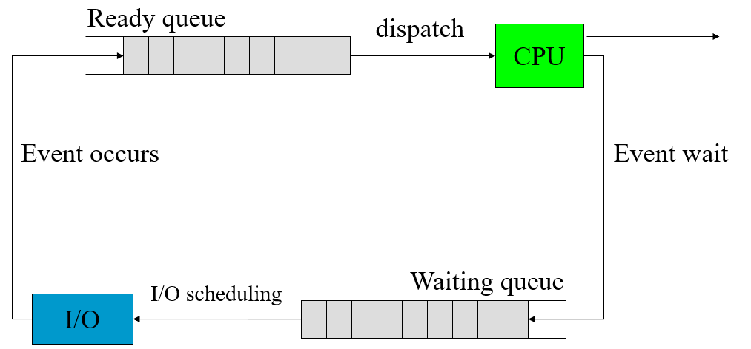
Convoy(护航) effect
All the other short/small processes wait for the one long/big process to get off the CPU.
lower CPU and device utilization.

Slide 17
Shortest-Job-First (SJF) Scheduling
associate with each process the length of next CPU burst.
the process with the shortest next CPU burst time will be selected.
If the next CPU bursts of two processes are the same, FCFS scheduling is used.
Two schemes:
nonpreemptive – once CPU is given to the process, it cannot be preempted until completes its CPU burst. Shortest-next-CPU-burst First
preemptive – if a new process arrives with CPU burst length less than remaining time of current executing process, preempt. Shortest-Remaining-Time-First (SRTF)
SJF is optimal – gives minimum average waiting time for a given set of processes.

Slide 18
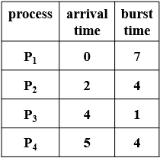
Example of Non-Preemptive SJF
P₁
•
P₂
•
P₃
•
P₄
•
0 1 2 3 4 5 6 7 8 9 10 11 12 13 14 15 16
P₁
P₃
P₂
P₄
0
2 4 5
7
8
12
16
Waiting time for P₁=0; P₂=6; P₃=3; P₄=7 Avg. (0+6+3+7)/4=4
turnaround time P₁=7; P₂=10; P₃=4; P₄=11 Avg. (7+10+4+11)/4=8

Slide 19
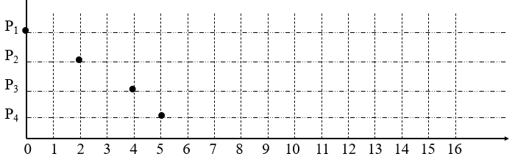
Example of Preemptive SJF--SRTF
P₁
P₂ P₁
P₄ P₁
P₁
P₁
P₂
P₃
P₂
P₄
P₁
0
2
4
5
7
11
16
Waiting time for P₁=9; P₂=1; P₃=0; P₄=2 Avg. (9 + 1 + 0 +2)/4 = 3
turnaround time P₁=16; P₂=5; P₃=1; P₄=6 Avg. (16+5+1+6)/4=7

Slide 20

Prediction of the Length of the Next CPU Burst
Can only estimate the length.
Can be done by using the length of previous CPU bursts, using exponential averaging.
t_{n} = actual length of nth CPU burst
τ_{n+1}= predicted value for the next CPU burst
α. 0 ≤ α ≤ 1
define:
α =0，τ_{n+1} = τ_{n}
α =1，τ_{n+1} = t_{n}
If we expand the formula, we get:
τ_{n+1}=α t_{n} + (1-α)α t_{n-1} +…+ (1-α)^{j}α t_{n-j} +…+ (1-α)^{n+1}τ₀

Slide 21
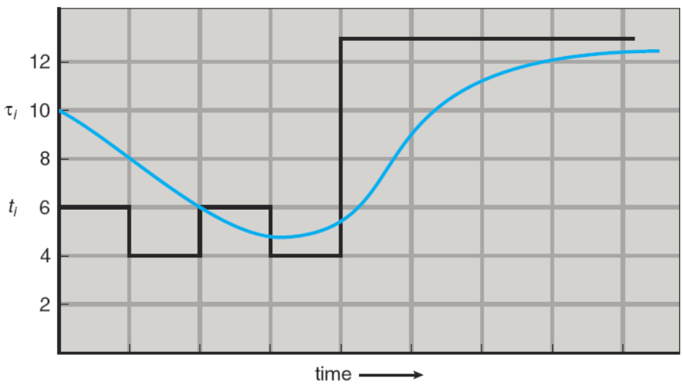
Prediction of the Length of the Next CPU Burst
CPU burst (t_{i}) 6 4 6 4 13 13 13
“guess” (τ_{i}) 10 8 6 6 5 9 11 12

Slide 22
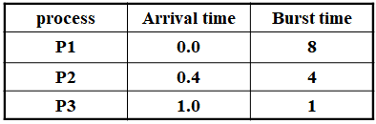
Exercise 1
a. What is the average turnaround time for these processes with the FCFS scheduling algorithm?
b. What is the average turnaround time for these processes with the SJF scheduling algorithm?
c. The SJF algorithm is supposed to improve performance, but notice that we chose to run process P1 at time 0 because we did not know that two shorter processes would arrive soon. Compute what the average turnaround time will be if the CPU is left idle for the first 1 unit and then SJF scheduling is used. Remember that processes P1 and P2 are waiting during this idle time, so their waiting time may increase. This algorithm could be known as future-knowledge scheduling.

Slide 23
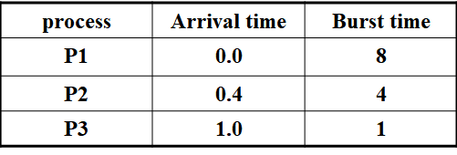
Answer a：FCFS scheduling algorithm
process | Waiting time | Turnaround time
P1
P2
P3
Average time

Slide 24
Answer b：SJF scheduling algorithm
process | Waiting time | Turnaround time
P1
P2
P3
Average time

Slide 25
Answer c：SJF future-knowledge scheduling algorithm
process | Waiting time | Turnaround time
P1
P2
P3
Average time

Slide 26
Exercise 2
In a computer system with only one processor, one input device and one printer. Processes A and B enter the system sequentially at time 0, and A is scheduled by the CPU scheduler at first. The execution tracks of A and B are as follows:
A: CPU burst lasting 20ms, then I/O burst of 100ms on the input device, and then CPU burst lasting 50ms, exiting.
B: CPU burst lasting 40ms, then I/O burst of 70ms on the printer, and then CPU burst lasting 30ms, exiting.
(a) Suppose that preemptive SJF scheduling algorithm (SRTF) is employed, draw the Gantt chart to describe the resource usage of A and B on the CPU, the input device and the printer.
(b) Calculate the waiting time and turnaround time for process A and B respectively. (c) Calculate the CPU utilization.

Slide 27
Answer
SRTF
A:
20
100 / input
50
B:
40
70 / printer
30

Slide 28
Priority Scheduling
照顾优先
A priority is associated with each process.
The CPU is allocated to the process with the highest priority.
Equal-priority processes are scheduled in FCFS order.
Usually, smallest integer ≡ highest priority, 0?
Priority can be defined either internally or externally.
SJF is a priority scheduling.
priority is the predicted next CPU burst time.
Two schemes:
Preemptive: preempt the CPU if the priority of the newly arrived process is higher than the priority of the currently running process.
Nonpreemptive: simply put the new process at the end of the ready queue.

Slide 29
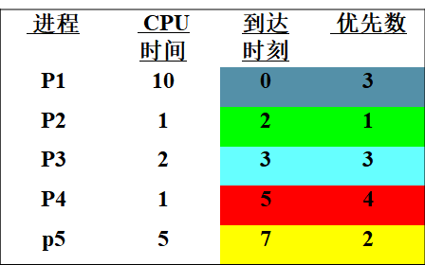

Example - static priority, non preemptive scheduling
Waiting time(等待时间)：
T1=0、T2=8、T3=13、T4=13、T5=4； Avg. WA=7.6
Turnaround time(周转时间)：
T1=10 、T2=9、T3=15、T4=14、T5=9； Avg. TA=11.4
P₁
•
P₂
•
P₃
•
P₄
•
P₅
•
0 1 2 3 4 5 6 7 8 9 10 11 12 13 14 15 16 17 18 19

Slide 30




Example - static priority, preemptive scheduling
Waiting time(等待时间)：
T1=8、T2=0、T3=9、T4=13、T5=0； Avg. : WA=6
Turnaround time(周转时间)：
T1=18 、T2=1、T3=11、T4=14、T5=5；Avg. : TA=9.8
P₁
•
P₂
•
P₃
•
P₄
•
P₅
•
0 1 2 3 4 5 6 7 8 9 10 11 12 13 14 15 16 17 18 19

Slide 31
Priority Scheduling
Problem: Starvation (or indefinite blocking)
low priority processes may never execute.
Solution: Aging
as time progresses increase the priority of the process.
For example
If priorities range from 127(low) to 0(high)
We could decrease the priority number of a waiting process by 1 every 15 minutes.
Eventually, even a process with an initial priority of 127 would have the highest priority in the system and would be executed.

Slide 32
Exercise 3
某系统采用基于动态优先级的抢占式调度算法，并且优先数越大的进程其优先级越高。
系统为所有新建进程赋予优先数 0; 当一个进程在就绪队列中等待CPU时，其优先数的变化速率为 α； 进程获得CPU后开始执行，执行过程中，其优先数的变化速率为β。
为参数 α 和 β 设置不同的值，则导致不同的调度算法。
问题：
a. 如果 β>α>0，则调度原则是什么？
b. 如果 α<β<0，则调度原则是什么？

Slide 33
解答a：如果 β>α>0，调度原则是FCFS
分析：
由于新建进程的优先数是 0， 具有最低优先级。
当它在就绪队列中等待时，进程的优先数以速率 α 增加，即优先级不断提高，所以最早进入就绪队列的进程，其优先级也最高。
优先级最高的队首进程获得调度。
当进程在CPU上执行时，它的优先数以速率 β 增加，β>α，任何ready状态的进程不可能具有比正在 running 的进程更高的优先级，所以，running进程将一直占有CPU，直到它执行结束。
然后，在就绪队列中等待时间最长的进程被调度到CPU上执行。
所以，调度原则是

Slide 34
解答b：如果 α<β<0，调度原则是LCFS
分析：
新建进程的优先数是 0，具有最高优先级。 由于新建进程的优先数是0， 一旦它进入就绪队列，它的优先数就开始以速率 α 减少，就绪时间越长，其优先数越小，即优先级越低。
新建进程优先级最高，被调度到CPU上执行。
running 状态的进程，其优先数以速率 β 减少，α<β<0，故任何ready 进程不可能具有比 running 进程更高的优先级。
新建进程抢占CPU。原来的执行进程进入就绪队列。
如果进程执行过程中，没有新建进程，则将一直占有CPU，直到它执行结束。然后，在就绪队列中等待时间最短的进程被调度到CPU上执行。
所以，调度原则是

Slide 35
Round Robin (RR) Scheduling
排队/轮流/公平
Similar to FCFS scheduling, but preemption is added.
Each process gets a small unit of CPU time (time quantum, or time slice), usually 10-100 ms. After this time has elapsed, the process is preempted and added to the end of the ready queue.
Keep the ready queue as a circular FIFO queue.
Set a timer to interrupt after 1 time slice.
Two cases: CPU burst of the running process
less than 1 time slice.
The process release the CPU voluntarily.
longer than 1 time slice.
timer will go off, time out interrupt, context switch. current running process will be put at the tail of the ready queue, the next process in the ready queue will be scheduled.

Slide 36
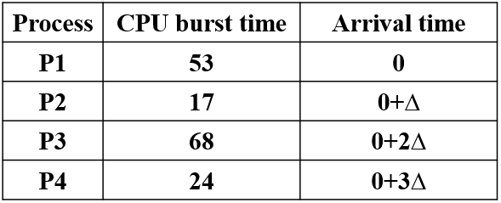
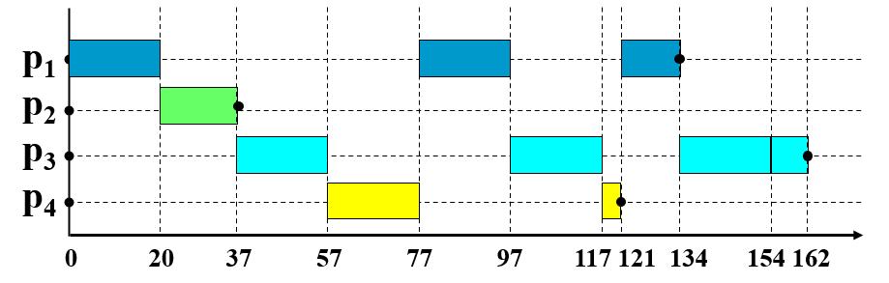

Example of RR with Time Quantum=20
preemptive
The Gantt chart is:
process | Waiting time | Turnaround time
P1 | 57+24=81 | 134
P2 | 20-0=20 | 37
P3 | 37+40+17=94 | 162
P4 | 57+40=97 | 121
Average time | 73 | 113.5

Slide 37
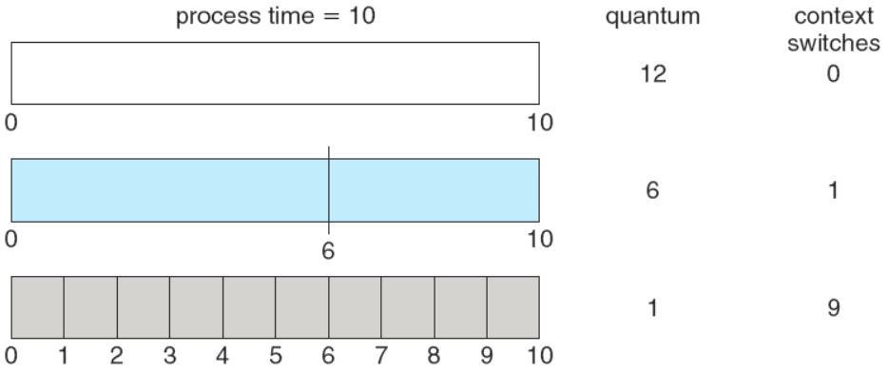
RR Scheduling
If there are n processes in the ready queue and the time slice is q, then each process gets 1/n of the CPU time in chunks of at most q time units. No process waits more than (n-1)q time units.
Performance depends on the size of the time slice
q very large (infinite) ⇒ FCFS
q very small ⇒a large number of context switch. q must be large with respect to context switch, otherwise overhead is too high.

Slide 38
Turnaround Time Varies With The Time Quantum
Process time
P₁ 6
P₂ 3
P₃ 1
P₄ 7
q=1
T₁ = 15;
T₂ = 9;
T₃ = 3;
T₄ = 17;
a_T = 11
q=2
T₁ = 14;
T₂ = 10;
T₃ = 5;
T₄ = 17;
a_T = 11.5
q=3
T₁ = 13;
T₂ = 6;
T₃ = 7;
T₄ = 17;
a_T = 10.75

Slide 39
Turnaround Time Varies With The Time Quantum
Process time
P₁ 6
P₂ 3
P₃ 1
P₄ 7
q=4
T₁ = 14;
T₂ = 7;
T₃ = 8;
T₄ = 17;
a_T = 11.5
q=5
T₁ = 15;
T₂ = 8;
T₃ = 9;
T₄ = 17;
a_T = 12.25
q=6
T₁ = 6;
T₂ = 9;
T₃ = 10;
T₄ = 17;
a_T = 10.5

Slide 40
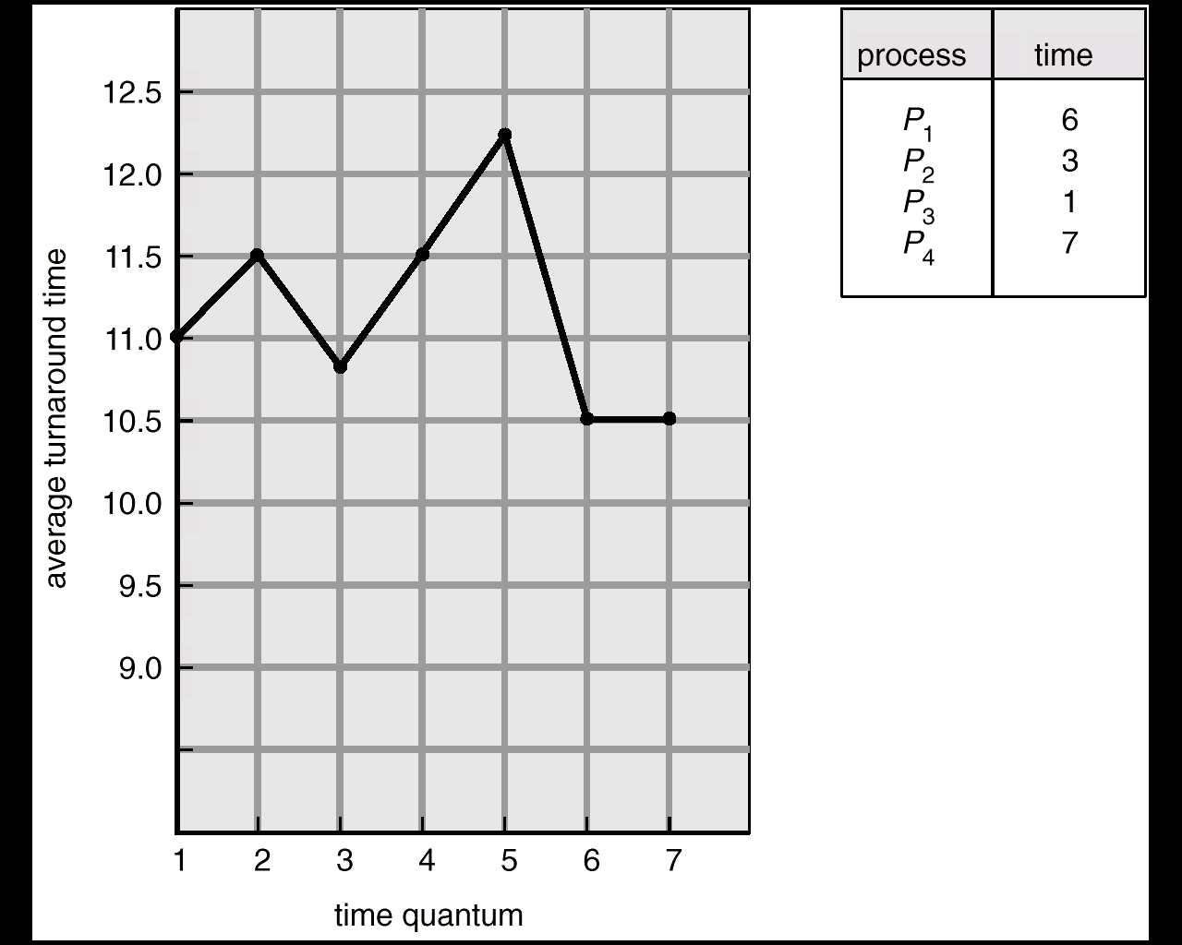
Turnaround Time Varies With The Time Quantum
A rule of thumb is that 80% of the CPU bursts should be shorter than the time quantum.

Slide 41
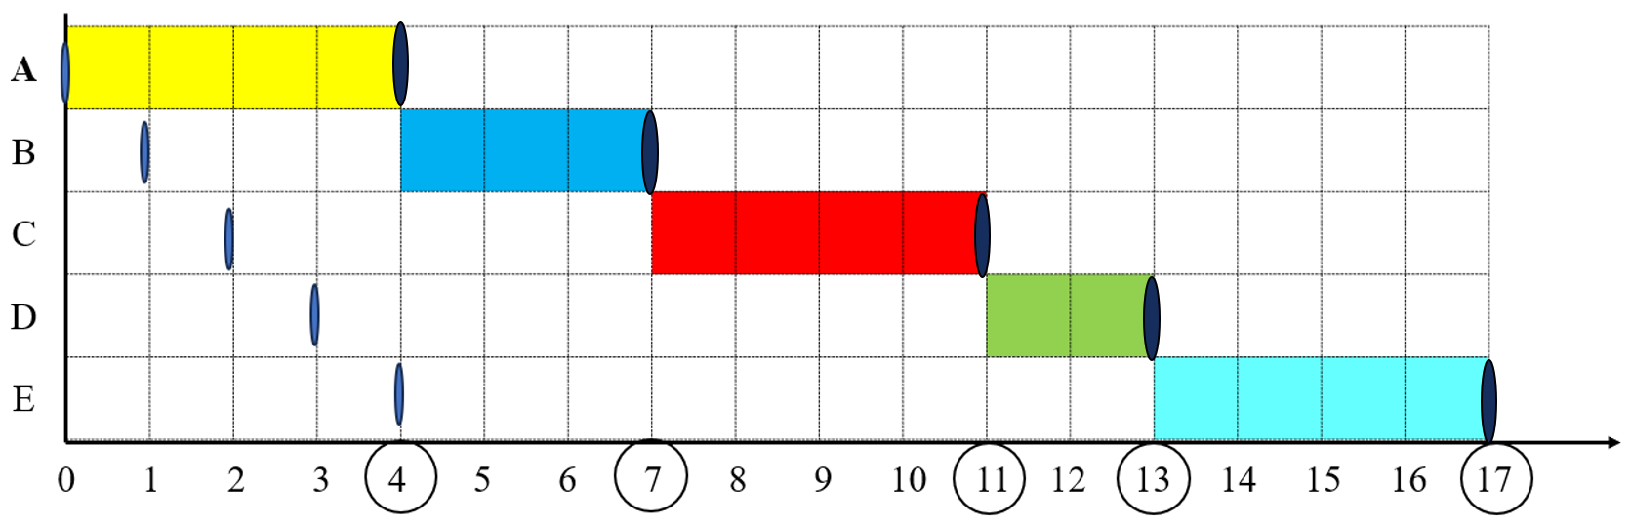
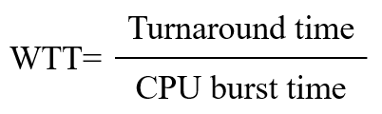
Exercise 4 RR(q=4)
Process | CPU burst time | Arrival time | Waiting time | Turnaround time | Weighted turnaround time
A | 4 | 0
B | 3 | 1-∆
C | 4 | 2-∆
D | 2 | 3-∆
E | 4 | 4-∆
Average time
Process | CPU burst time | Arrival time | Waiting time | Turnaround time | Weighted turnaround time
A | 4 | 0
B | 3 | 1-∆
C | 4 | 2-∆
D | 2 | 3-∆
E | 4 | 4-∆
Average time
0
4
1
3
6
2
5
9
2.25
8
10
5
9
13
3.25
5
8.4
2.7

Slide 42
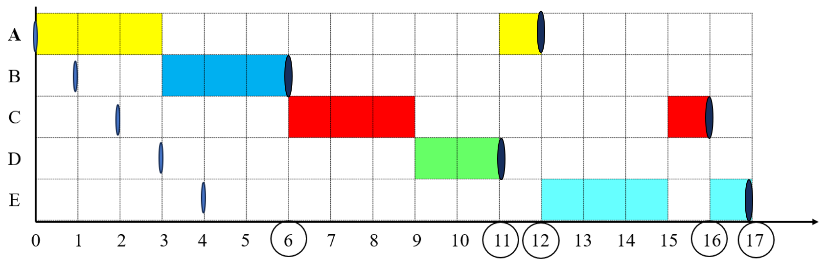
Exercise 4 RR(q=3)
Process | CPU burst time | Arrival time | Waiting time | Turnaround time | Weighted turnaround time
A | 4 | 0
B | 3 | 1-∆
C | 4 | 2-∆
D | 2 | 3-∆
E | 4 | 4-∆
Average time
Process | CPU burst time | Arrival time | Waiting time | Turnaround time | Weighted turnaround time
A | 4 | 0
B | 3 | 1-∆
C | 4 | 2-∆
D | 2 | 3-∆
E | 4 | 4-∆
Average time
8
12
3
2
5
1.67
10
14
3.5
6
8
4
9
13
3.25
7
10.4
3.084

Slide 43
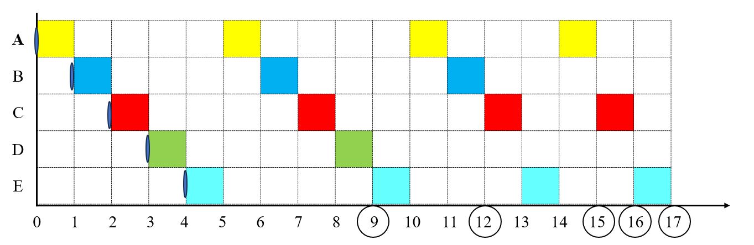

Exercise 4 RR(q=1)
Process | CPU burst time | Arrival time | Waiting time | Turnaround time | Weighted turnaround time
A | 4 | 0
B | 3 | 1-∆
C | 4 | 2-∆
D | 2 | 3-∆
E | 4 | 4-∆
Average time

Slide 44
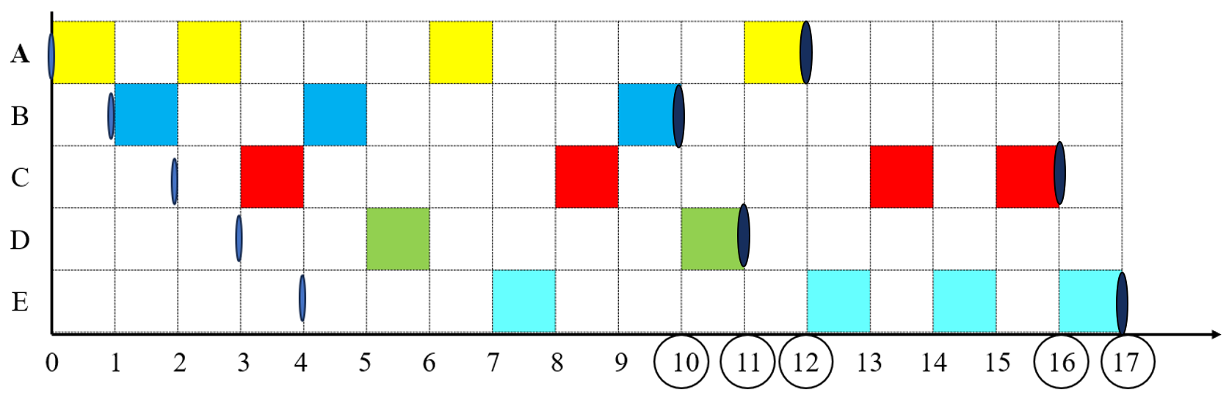
Exercise 4 RR(q=1)
Process | CPU burst time | Arrival time | Waiting time | Turnaround time | Weighted turnaround time
A | 4 | 0
B | 3 | 1-∆
C | 4 | 2-∆
D | 2 | 3-∆
E | 4 | 4-∆
Average time
8
12
3
6
9
3
10
14
3.5
6
8
4
9
13
3.25
7.8
11.2
3.35

Slide 45
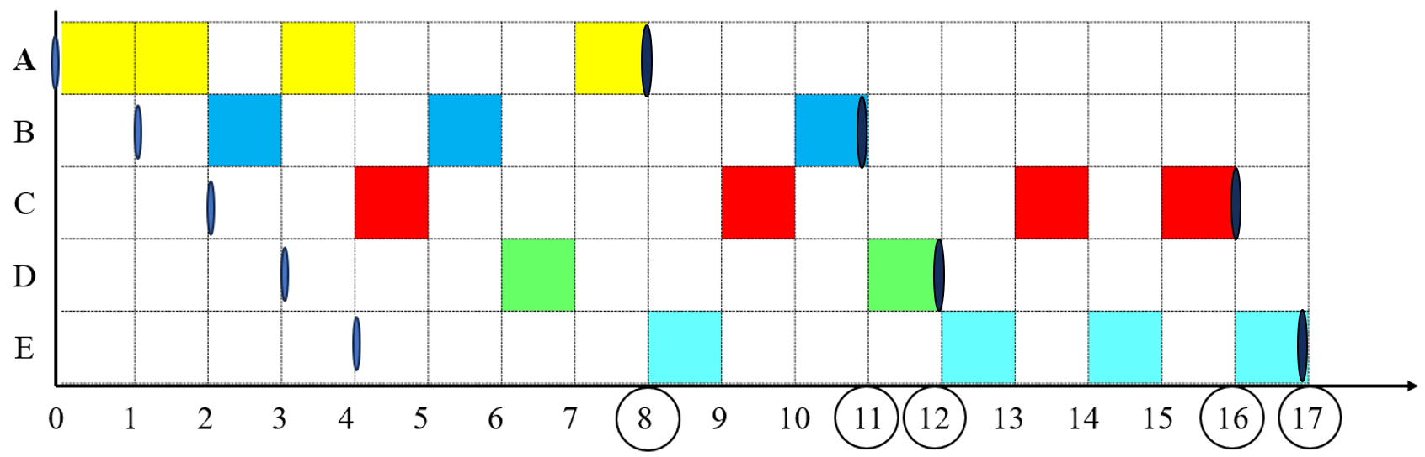
Exercise 4 RR(q=1)
Process | CPU burst time | Arrival time | Waiting time | Turnaround time | Weighted turnaround time
A | 4 | 0
B | 3 | 1+∆
C | 4 | 2+∆
D | 2 | 3+∆
E | 4 | 4+∆
Average time
4
8
2
7
10
3.33
10
14
3.5
7
9
4.5
9
13
3.25
7.4
10.8
3.316

Slide 46
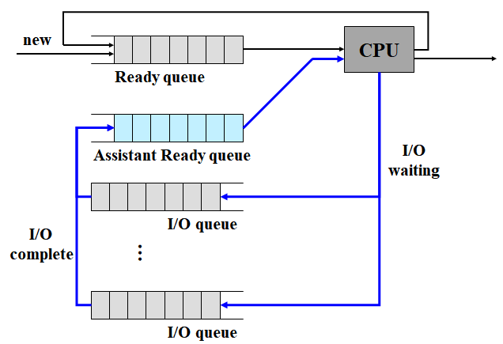
Virtual Round Robin Scheduling
Revised RR
结合实际，
体验更好！

Slide 47
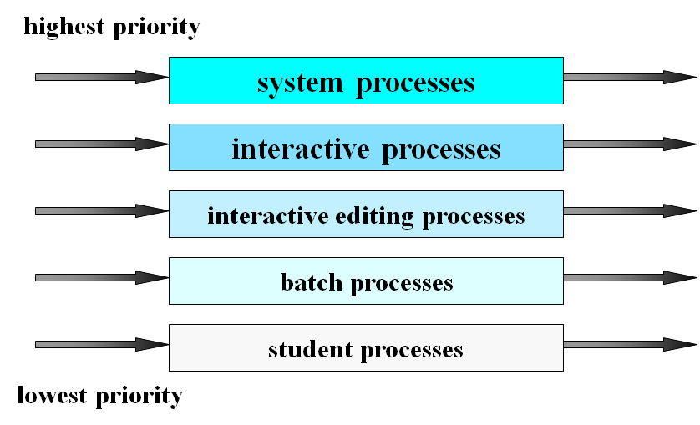
Multilevel Queue Scheduling
Multiple separate queues:
foreground (interactive)
background (batch)
Each queue has its own scheduling algorithm
foreground – RR
background – FCFS
Scheduling must be done between the queues.
Fixed priority preemptive scheduling; Possibility of starvation.
Time slice each queue gets a certain amount of CPU time which it can schedule amongst its processes; i.e., 80% to foreground in RR, 20% to background in FCFS

Slide 48
Multilevel Feedback Queue Scheduling
A process can move between the various queues.
To separate processes with different CPU-burst characteristics.
If a process uses too much CPU time, it will be moved to a lower-priority queue.
Leaves I/O-bound and interactive processes in the higher-priority queues.
If a process waits too long in a lower-priority queue, it may be moved to a higher-priority queue.
This form of aging prevents starvation.
Three queues:
Q₀ -- highest priority – time slice 8 ms
Q₁ -- lower priority – time slice 16 ms
Q₂ -- lowest priority – FCFS
Scheduling
Q₀, FCFS，Quantum=8
Q₁, FCFS，Quantum=16
Q₂, FCFS

Slide 49
Multilevel Feedback Queue Scheduling
Multilevel-feedback-queue scheduler is defined by the following parameters:
the number of queues.
the scheduling algorithms for each queue.
the method used to determine when to upgrade a process to a higher-priority queue.
the method used to determine when to demote a process to a lower-priority queue.
the method used to determine which queue a process will enter when that process needs service.

Slide 50
Highest Response-Ratio Next Scheduling
高响应比优先(HRRN)算法
Non-preemptive scheduling algorithm.
Response-Ratio ： R=(W+T)/T=1+W/T
W：waiting time in ready queue
T：CPU-burst time
The process with the highest response-ratio will be scheduled next.
HRRN considers the waiting time and CPU-burst time simultaneously.
Time consuming, system overhead to calculate the response-ration for each processes.

Slide 51
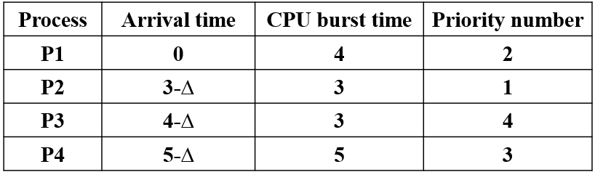
Exercise 5
Consider the following set of processes P1, P2, P3 and P4. For 1≤ i ≤4, the following table shows their arrival time, CPU-burst time, and their priority number. Here, a smaller priority number implies a higher priority.
(1) Suppose that nonpreemptive priority scheduling is employed,
Draw a Gantt chart illustrating the execution of these processes.
What are the average waiting time and the average turnaround time.
(2) Suppose that HRRN scheduling is employed,
Draw a Gantt chart illustrating the execution of these processes.
What are the average waiting time and the average turnaround time.

Slide 52
Answer (1) Priority

Slide 53
Answer (2) HRRN
RR = (W+T)/T
= 1+W/T

Slide 54
Scheduling-Algorithms Summary
尊老
爱幼
照顾优先
排队
平等
等级秩序
公平
防饥饿
FCFS
SJF
Priority Scheduling
RR
Multilevel Queue Scheduling
Multilevel Feedback Queue Scheduling
HRRN
non-preemptive
non-preemptive
preemptive
non-preemptive
preemptive
preemptive
preemptive
preemptive
non-preemptive

Slide 55
5.4 Multiple-Processor Scheduling
CPU scheduling more complex when multiple CPUs are available.
Classifications of Multiprocessor Systems
Loosely coupled multiprocessor
Each processor has its own memory and I/O channels
Tightly coupled multiprocessing
Processors share main memory
Controlled by operating system
Functionally specialized processors
Such as I/O processor
Controlled by a boss processor
Homogeneous processors: within a multiprocessor, any available processor can be used to run any processes in the queue.
Heterogeneous system: only programs compiled for a given processor’s instruction set could be run on that processor.

Slide 56
Approaches to Multiple-Processor Scheduling
Asymmetric multiprocessing
Boss processor handles all scheduling decisions, I/O processing, and other system activities.
Other slave processors execute only user code.
Only boss processor accesses the system data structures, reducing the need for data sharing.
Slave processor sends service request to the boss.
Disadvantages
Failure of boss brings down whole system.
Boss can become a performance bottleneck.

Slide 57
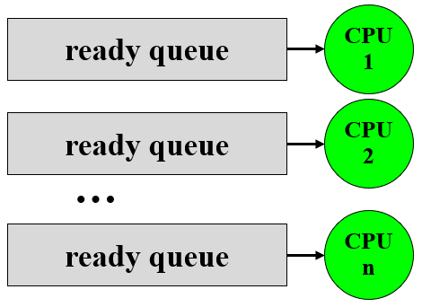
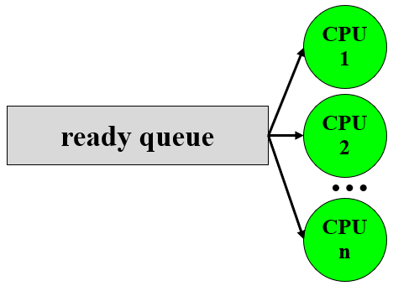
Approaches to Multiple-Processor Scheduling
Symmetric multiprocessing(SMP)
Peer architecture (symmetric multiprocessing)
Operating system can execute on any processor.
Each processor is self-scheduling.
Ready queue, two alternations:
Each processor has its own private ready queue.
A common ready queue
Using private queue, permanently assign process to a processor
Possible to provide a dedicate ready queue for each processor
Problem: load imbalance.
Using common queue, must ensure:
two processors do not choose the same process.
processes are not lost from the queue.

Slide 58
Processor Affinity
Processor Affinity (亲和性)
A process has an affinity for the processor on which it is currently running.
keep a process running on the same processor.
Migration problem: high cost of invalidating and re-populating cache memory.
Take forms, two alternations:
Soft affinity
OS has a policy of attempting to keep a process running on the same processor, but doesn't guarantee that it will do so.
Hard affinity
The OS provides system calls, allowing a process to specify a subset of processors on which it may run.
The main-memory architecture of a system can affect processor affinity issues.

Slide 59
Processor Affinity
NUMA (non-uniform memory access)
CPU has faster access to some parts of main memory than to other parts.
Typically, this occurs in systems containing combined CPU and memory boards. The CPUs on a board can access the memory on that board faster than they can access memory on other boards in the system.

Slide 60
Load balancing
Load balancing: keep the workload evenly distributed across all processors in an SMP system.
Load balancing is only necessary on systems where each processor has its own private ready queue.
Two approaches:
Push migration: a specific task periodically checks the load on each processor, if imbalance, pushing processes from overloaded processor to idle or less-busy ones.
Pull migration: an idle processor pulls a waiting task from a busy processor.
Often counteracts the benefits of processor affinity.

Slide 61
Multiprocessor Thread Scheduling
Load sharing
Processes are not assigned to a particular processor
Gang scheduling
A set of related threads is scheduled to run on a set of processors at the same time.
Dedicated processor assignment
Threads are assigned to a specific processor
Dynamic scheduling
Number of threads can be altered during course of execution

Slide 62
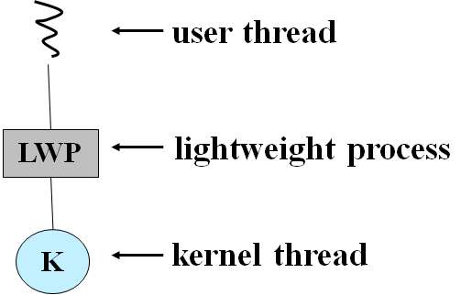
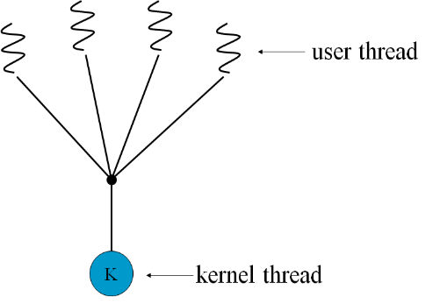
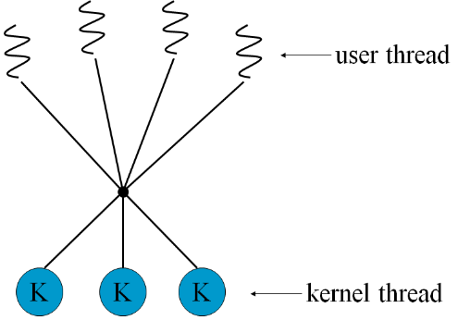
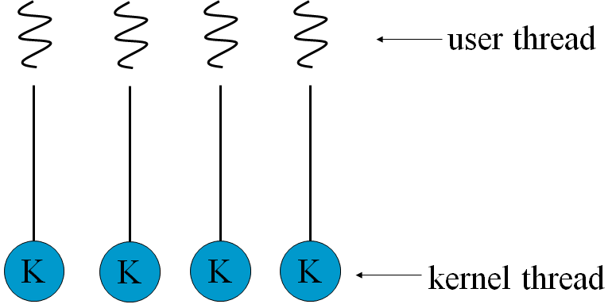
5.5 Thread Scheduling
Contention(竞争) Scope
process-contention scope (PCS). The thread library schedules user-level threads to run on an available LWP. competition for the CPU takes place among threads belonging to the same process.
system-contention scope (SCS). Kernel decide which kernel-level thread to schedule onto a CPU. Competition for the CPU with SCS scheduling takes place among all threads in the system.
Thread Scheduling
Local Scheduling , process-contention scope (PCS) m:1 and m:n model
Global Scheduling, System-contention scope (SCS) 1:1 model uses only SCS.

Slide 63
Thread Scheduling
Pthread Scheduling
API allows specifying either PCS or SCS during thread creation.
PTHREAD_SCOPE_PROCESS schedules threads using PCS scheduling.
PTHREAD_SCOPE_SYSTEM schedules threads using SCS scheduling.
On systems implementing the many-to-many model
PTHREAD_SCOPE_PROCESS policy schedules user-level threads onto available LWPs. The number of LWPs is maintained by the thread library.
PTHREAD_SCOPE_SYSTEM policy will create and bind an LWP for each user-level thread, effectively mapping threads using the one-to-one policy.
Can be limited by OS. Linux and Mac OS X only allow PTHREAD_SCOPE_SYSTEM

Slide 64
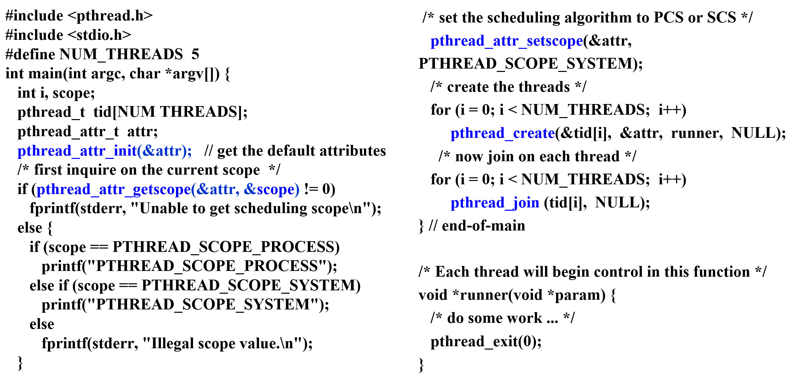
Pthread Scheduling API

Slide 65
5.6 Operating System Examples
Linux scheduling
Preemptive, priority-based scheduling
Windows XP scheduling
Priority-based, preemptive scheduling (multi-queue)
Solaris scheduling
Priority-based thread scheduling
When time slice runs out, priority lowered;
when resumed from waiting, priority is boosted.

Slide 66
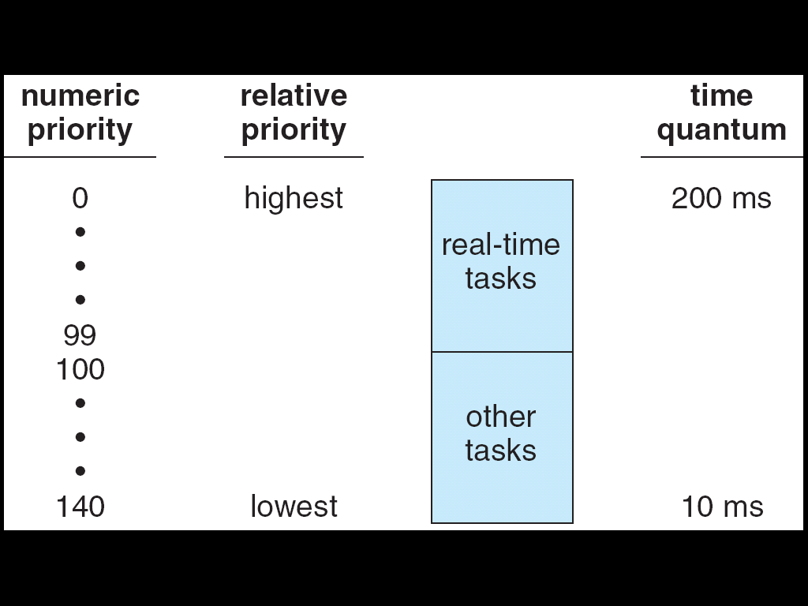
Linux Scheduling
Scheduling is based on scheduling classes.
Based on priority
Real-time (0-99)
Soft real-time, static priorities
Posix.1b compliant. -- two classes:
FCFS and RR
Highest priority process always runs first
Time-sharing (100-140)
Prioritized credit-based. process with most credits is scheduled next.
Credit subtracted when timer interrupt occurs
When credit = 0, another process chosen
When all processes have credit = 0, recrediting occurs
Based on factors including priority and history
dynamic priorities, nice values +/- 5.

Slide 67
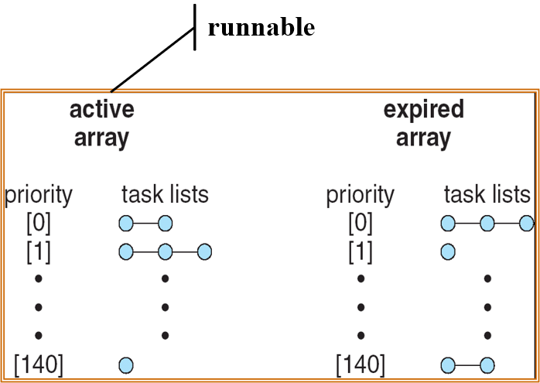
List of Tasks Indexed According to Priorities
The kernel maintains a list of all runnable task in a runqueue data structure, each runqueue contains two priority arrays.
Each processor maintains its own runqueue, schedules itself.
When all task have exhausted their time slice, the two priority arrays are exchanged.
The recalculation of a task’s dynamic priority occurs when the task has exhausted its time slice and is to be moved to the expired array.

Slide 68
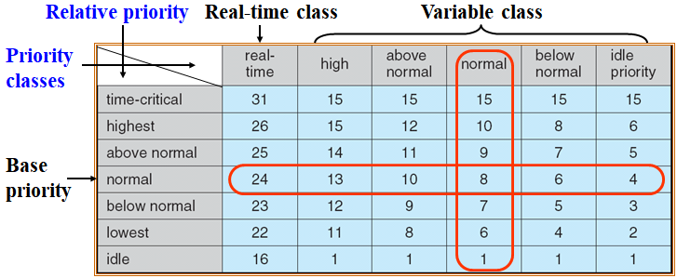
Windows XP Priorities
priority-based preemptive scheduling
Real-time threads can preempt non-real-time
32-level priority scheme
Priority 0 is memory-management thread
Variable class is 1-15
real-time class is 16-31
Multilevel-queue
queue for each priority
If no run-able thread, runs idle thread.
The priority of each thread is based on the priority class and its relative priority
Processes, typically NORMAL_PRIORITY_CLASS
Thread, its initial priority, typically the base priority of the process.
When time slice runs out, priority lowered, but never lowered below the base priority; when resumed from a wait operation, priority is boosted.

Slide 69
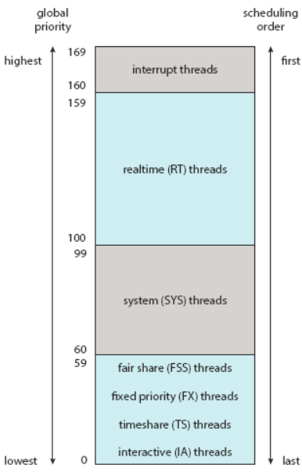
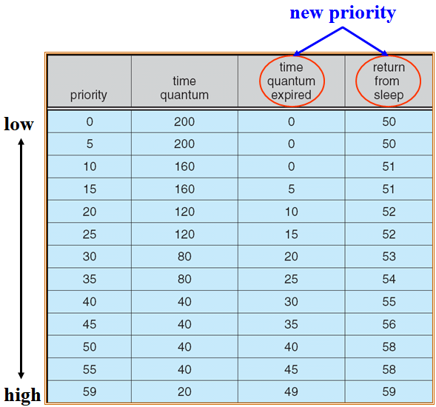
Solaris Scheduling
priority-based thread scheduling.
with the same priority, RR
Each thread belongs to one of six classes.
Within each class, different priorities and scheduling algorithms.
default scheduling class for a process is time sharing.
Dispatch Table for interactive/time-sharing threads, multilevel feedback queue
When time slice runs out, priority lowered;
when resumed from waiting, priority is boosted.

Slide 70
5.7 Algorithm Evaluation
Defining the criteria to be used in selecting an algorithm.
CPU utilization, response time, or throughput
Define the relative importance of these measures
Maximum CPU utilization under the constraint that the maximum response time is 1 second.
Maximum throughput such that turnaround time is linearly proportional to total execution time.
Deterministic modeling
Queuing models
Simulations
Implementation

Slide 71

课后作业及研究性学习
作业：
掌握CPU调度决策模式
掌握各种调度算法的执行原理
研究性学习
为特定系统选择CPU调度算法的评估标准
国产CPU芯片调研
A1：openEuler
CPU调度

Slide 72
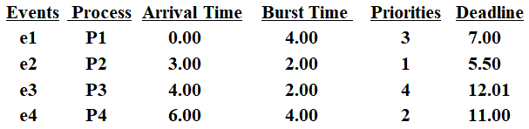
Exercise 6
Considering a real-time system, in which there are 4 real-time processes P1, P2, P3 and P4 that are aimed to react to 4 critical environmental events e1, e2, e3 and e4 in time respectively.
The arrival time of each event ei, 1≤i≤4, (that is, the arrival time of the process Pi), the length of the CPU burst time of each process Pi, and the deadline for each event ei are given below. Here, the deadline for ei is defined as the absolute time point before which the process Pi must be completed.
The priority for each event ei (also for Pi) is also given, and a smaller priority number implies a higher priority.
Draw a Gantt chart illustrating the execution of these processes using the following scheduling algorithms: preemptive priority and FCFS.
What is the average waiting time for each of the scheduling algorithms?
What is the average turnaround time each of the scheduling algorithms?
Which event will be treated with in time for each of the scheduling algorithms? ( that is, the process reacting to this event will be completed before its deadline?)

Slide 73
Answer to exercise 6

Slide 74
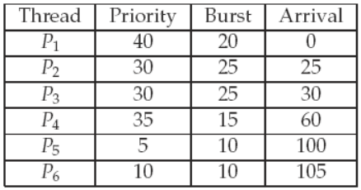
Exercise 7
There are 6 concurrent processes in the system. The following table shows their priority number, arrival time, and CPU burst time. Assuming a higher number indicating a higher relative priority, and the length of a time quantum is 10 units.
In addition to these processes, the system also has an idle task (which consumes no CPU resources and is identified as Pidle ). This task has priority 0 and is scheduled whenever the system has no other available processes to run.
If a process is preempted by a higher-priority process, the preempted process is placed at the end of the ready queue.
Answer the following questions based on the scheduling algorithm adopted by the system.
Show the scheduling order of the processes using a Gantt chart.
What is the turnaround time for each process?
What is the waiting time for each process?
What is the CPU utilization rate?

Slide 75
Exercise 7
The scheduling algorithm adopted by the system:
(a) Assuming the round-robin scheduling algorithm is used.
(b) Assuming the non-preemptive priority scheduling algorithm is used.
(c) Assuming the preemptive priority scheduling algorithm is used.
(d) Assuming the non-preemptive priority with round-robin for processes with equal priority scheduling algorithm is used.
(e) Assuming the preemptive priority with round-robin for processes with equal priority scheduling algorithm is used.
(f) Assuming the round-robin with preemptive priority scheduling algorithm is used, a new process with higher priority will preempt the CPU for execution, and executing up to one time slice, when the time slice is runs out, the process is placed at the end of the ready queue.

Slide 76
Answer to exercise 7– (a) RR

Slide 77
Answer to exercise 7–(b) Non-preemptive priority

Slide 78
Answer to exercise 7–(c) Preemptive priority

Slide 79
Answer to exercise 7–(d) non-preemptive priority with RR

Slide 80
Answer to exercise 7–(e) preemptive priority with RR

Slide 81
Answer to exercise 7–(f) RR with preemptive priority

Slide 82
A1：openEuler CPU调度
FCFS + Priority
RR + Priority
Time slice: 100ms
Priority

Slide 83
Priority
每个优先级，一个进程链表（队列）
每个进程有自己的调度策略
FCFS
RR，时间片结束后，回到同优先级队列队尾。
优先级范围：0（H）~99（L）
Bitmap,
Bit[i]=0, 优先级i的进程队列空
Bit[i]=1, 优先级i的进程队列非空
queue[100], 队列头结点数组
i， 优先级

Slide 84
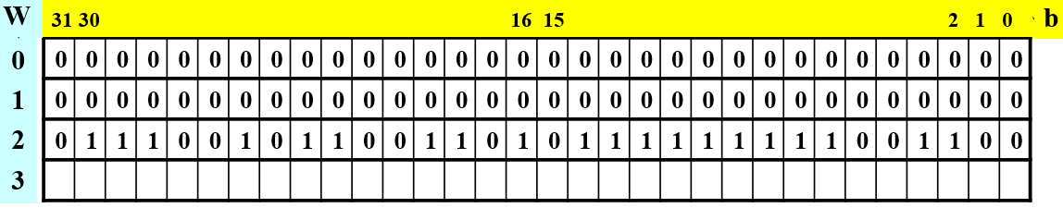
Priority
调度
查看优先级Bitmap，找到第一个非0位，计算出相对应的优先级i；
访问queue[i]，该链表中第一个进程被选中作为下一个要运行的进程。
66
计算非空最高优先级:
(number of bits per word) *(number of 0-value words) + offset of first 1 bit
CPUs have instructions to return offset within word of first “1” bit.

Slide 85
多核调度
多队列调度策略
每个CPU维护一个调度队列
每个CPU运行自己的调度程序，从自己的调度队列中选进程
负载均衡问题
每个处理器有一个迁移线程（migration/CPU-ID）
每个迁移线程有一个由函数组成的停机工作队列
迁移线程每次从停机工作队列中取出一个函数执行
只要队列不空，迁移线程会一直运行，直到所有函数都被执行，队列空。
函数：将进程从一个CPU迁移到另一个CPU
迁移线程优先级最高，可以抢占其他所有进程，而不被其他进程抢占。

Slide 86
多核调度
负载均衡的实现
CPU₀向CPU₁的停机工作队列中添加一个函数，并唤醒CPU₁上的迁移线程；
CPU₁上的迁移线程抢占其他进程，第一时间从停机工作队列中取出函数执行；
将进程从CPU₁迁移到CPU₀。

Slide 87
CFS（Completely Fair Scheduler）
openEuler 的核心进程调度策略：标准轮流分时调度策略，采用算法CFS（Completely Fair Scheduler）。
openEuler中进程类别及调度策略
限期进程，限期调度策略（SCHED_DEADLINE），选择截止时间最近的进程；
实时进程，SCHED_FIFO，SCHED_RR
普通进程，SCHED_NORMAL策略，采用CFS算法
openEuler使用了多个调度器（scheduler）
将公共部分抽象出来，使用调度类来表示
一个调度类表示一个具体实现的调度器
每个CPU有5种主要的调度类，每个调度类有一个优先级

Slide 88
openEuler中的调度类（优先级H→L）
停机调度类
停机进程，目前只有迁移线程属于此类
限期调度类
限期进程，选择绝对截止期限最小的进程
实时调度类
实时进程，为每个优先级维护一个进程链表，选择优先级最高的第一个进程，进程的掉测策略FCFS、RR
公平调度类
普通进程，CFS算法
空闲调度类
空闲进程，0号进程（idle）

Slide 89
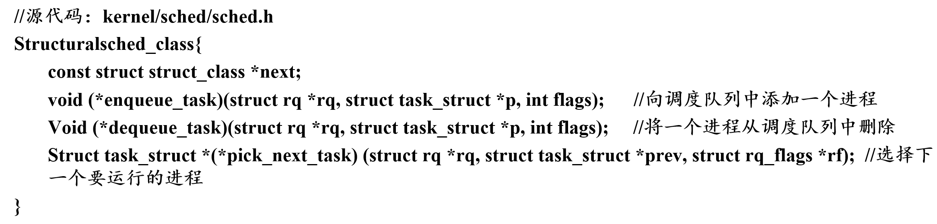
openEuler使用的调度类结构体
Sched_class

Slide 90
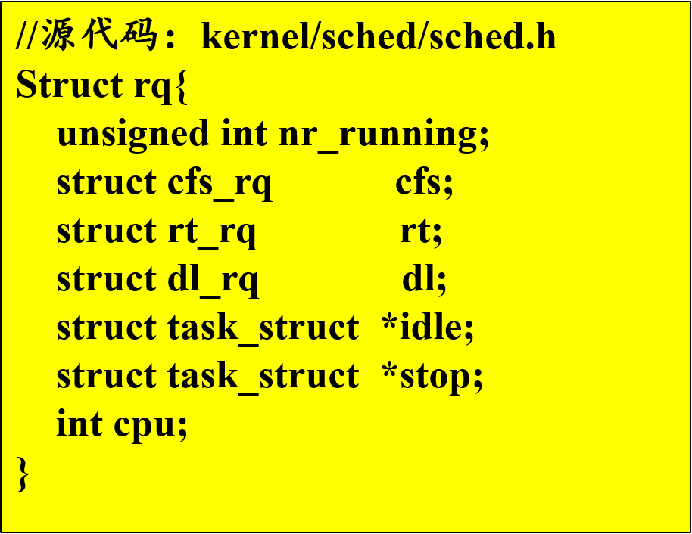
调度队列和调度实体
OpenEuler中，每个处理器都有一个调度队列。
结构体rq：
每个调度类在每个处理器上都有该调度类管理的调度队列和调度进程。
调度队列中保存调度实体，而不是PCB
调度实体中保存了CPU调度所需信息
一个调度实体唯一代表一个进程
在创建进程PCB时，OS根据进程所属调度类型初始化对应的调度实体，再将调度实体添加到调度类管理的调度队列中。

Slide 91
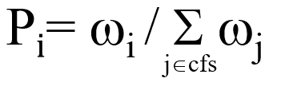
CFS调度策略
一个调度时延内的所有进程都有机会被调度到
调度时延：进程两次获得CPU的时间间隔
根据进程优先级和当前系统负载为每个进程分配一定比例的CPU处理时间。
处理时间根据nice值计算
nice值
相对优先级，范围：-20~=19
值越低表示优先级越高
为高优先级进程分配更高比例的CPU处理时间
计算分配比例，根据权重值，而不是nice值

Slide 92
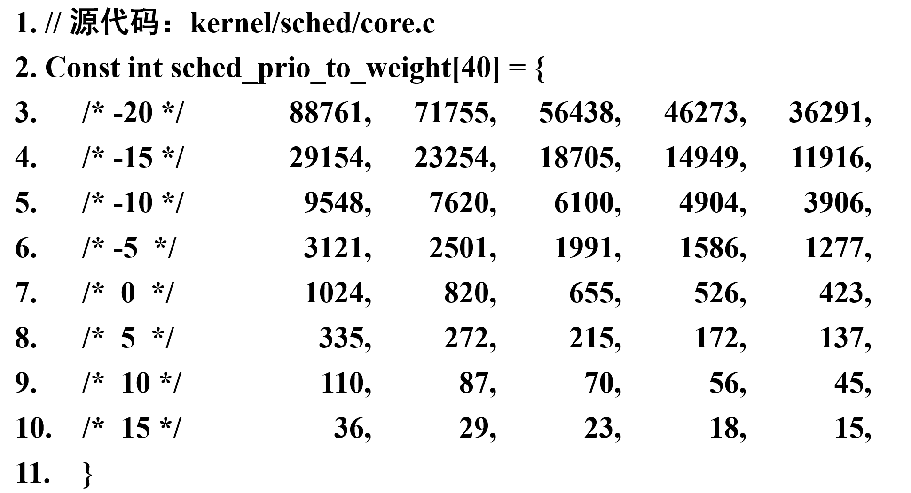
CFS调度策略
nice值/权重对应表：

Slide 93
CFS调度策略
计算进程分配的时间片
根据就绪进程的数量和最小粒度时间来确定
先确定调度时延。
如果就绪进程个数（nr_running）<=sched_nr_latency（默认值8）， 则调度时延=6ms
否则，需要保证每个进程至少运行最小粒度时间sysctl_sched_min_granularity（缺省值0.75ms）， 调度时延=就绪进程个数* sysctl_sched_min_granularity

Slide 94
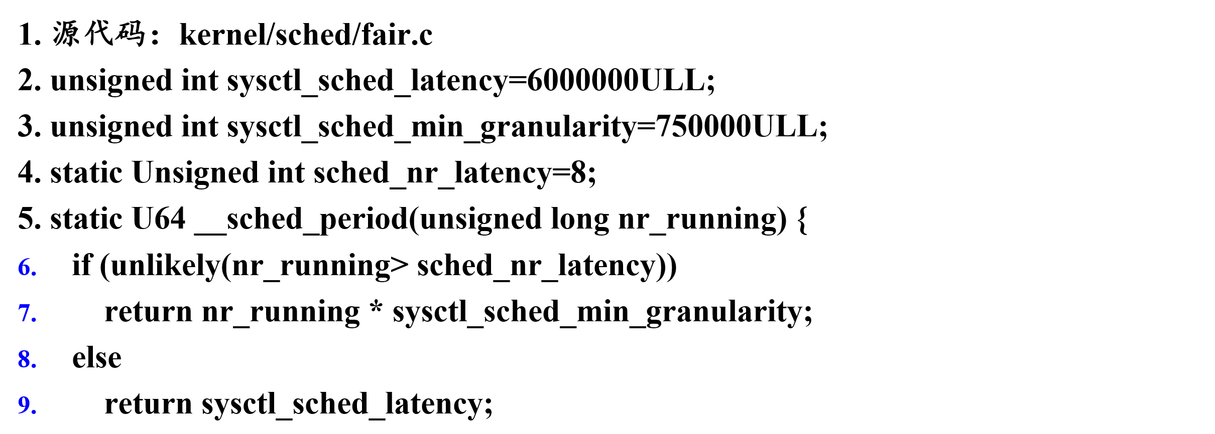
CFS调度策略

Slide 95

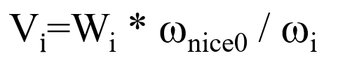
CFS调度策略
计算进程分配的时间片
计算进程分配的实际运行时间Wi：
计算进程的虚拟运行时间Vi:
ω_{nice0} 表示nice值为0时的权重
将进程按照虚拟运行时间从小到大排序，每次调度选择虚拟运行时间最小的进程。

Slide 96
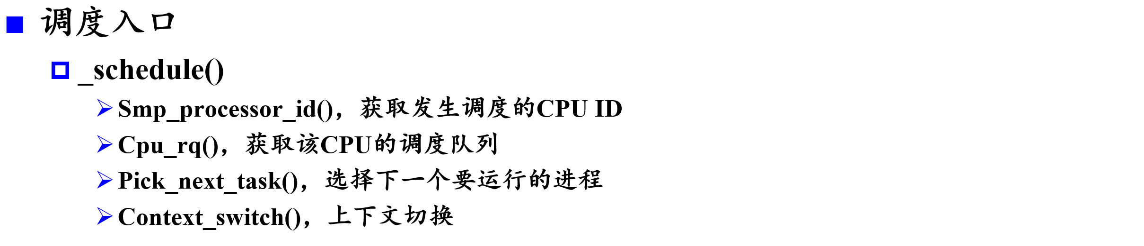
调度过程
openEuler发生调度的情况
主动调度：运行中的进程调度sched_yield()或者schedule()主动让出CPU。
周期性调度：OS强迫当前进程让出CPU。
唤醒阻塞的进程：被唤醒的而进程可能抢占当前进程。
创建新进程：新进程可能会抢占当前进程。

Slide 97
调度过程
pick_next_task()
如果当权CPU的调度队列上的进程数量等于CFS调度队列上的就绪进程数量，则让CFS调度类从CFS调度队列中选择下一个要运行的进程。
否则，for_each_class()按照优先级顺序依次调用每个调度类实现的函数pick_next_task()
在某个pick_next_task()找到需要调度的进程之后，直接返回被窜则的进程，不再调用其他调度类实现的函数pick_next_task()。

Slide 98
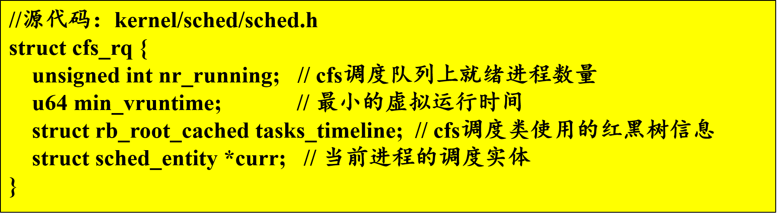
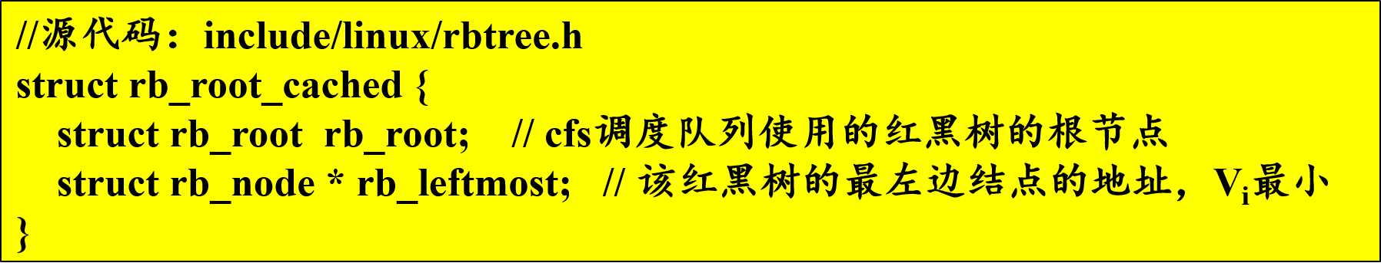
调度过程
CFS选择进程pick_next_task_fair()
CFS调度类的调度队列使用结构体cfs_rq表示
结构体rb_root_cached：

Slide 99
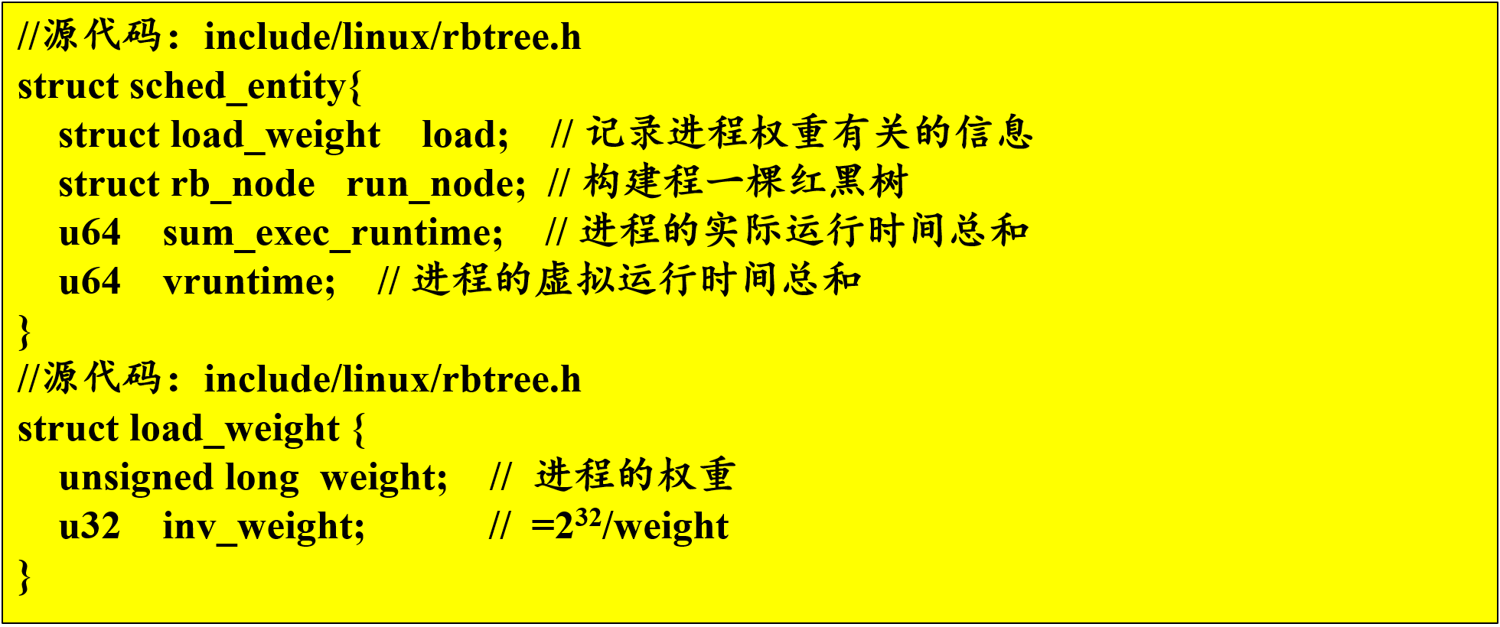
调度过程
调度实体使用结构体sched_entiry表示

Slide 100
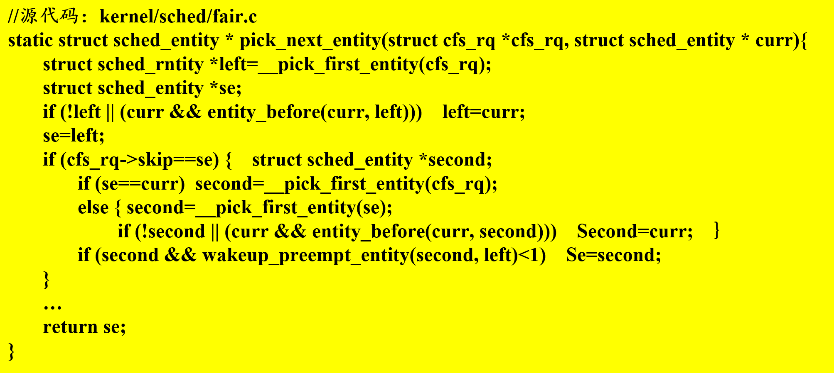
调度过程
pick_next_task_fair()的实现
关键是函数pick_next_entity()

